Slide 1
IDS 702 Final Presentation NBA Sports Betting
Leon Zhang
Notes:
Hello everyone. I am Leon, and I will be presenting my final project about sports betting in NBA.

Slide 2
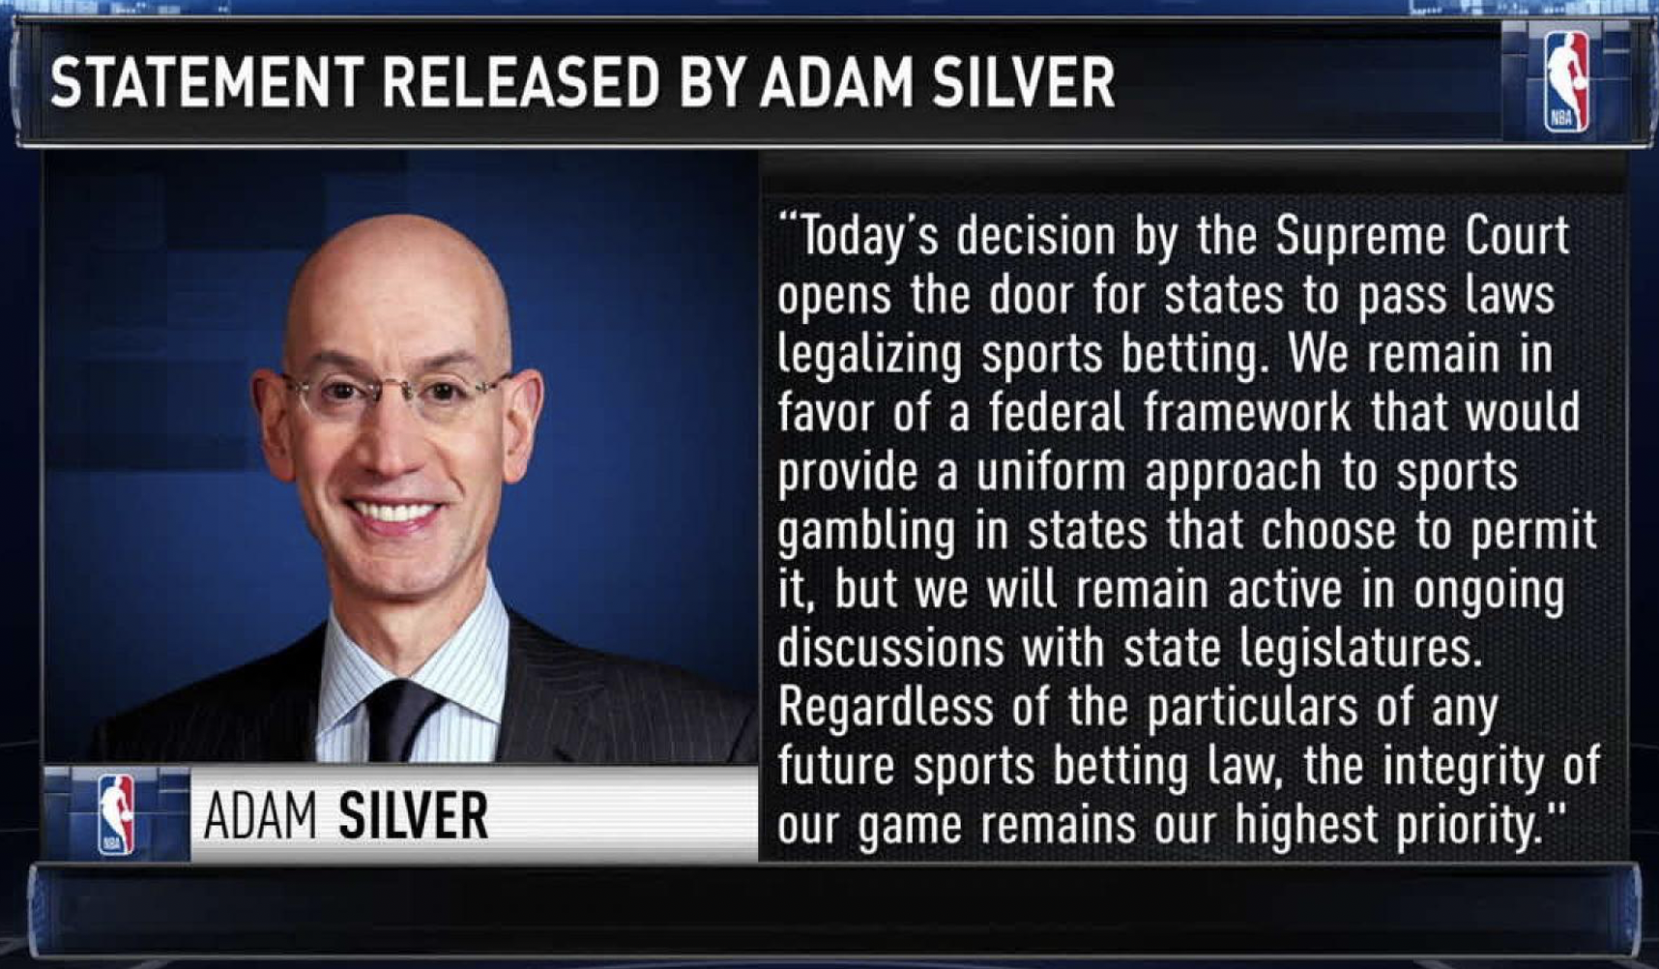
Introduction
2019: NBA legalized sports betting
$238 billion market in United States for legal betting market
Expanding market with tremendous growth
APIs available for automated betting bot
NBA commissioner announcing the legalization of sports betting
Notes:
So why sports betting? I believe sports betting is a great place to apply data science. It is a new and fast-growing field and in 2019 it has been legalized by the NBA officials opening up a $200 billion market. Many bookie websites are also offering APIs that allow people to build automated betting bots, just like trading bots for stocks. I think this is really cool

Slide 3
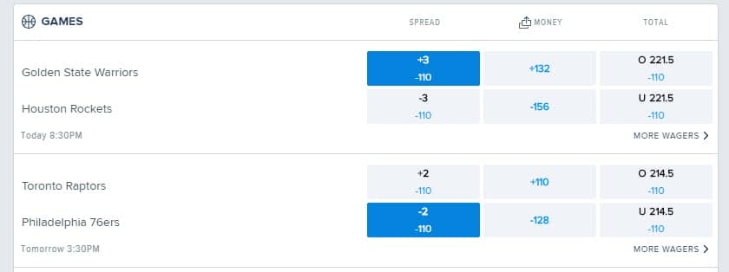
Scope
Inference based vs Predictive based
Pregame Betting vs In-game Betting
Types of Betting:
Spread
Money line
Totals: Over/Under
Spread, Money line, and Total betting mechanism
Notes:
For this project, I will be focusing on the inference side rather than the prediction side. To simplify the problem, I will be only doing pregame betting meaning that bets are placed before the game starts not during the game. Moreover, there are mainly three types of bets: spread, money line and totals. I will be only doing money line, which is the simplest one, you place bet on the teams that you think will win the game.

Slide 4
Data
Predictors: what do we know before the game
Game data:
Average team points, average assists, average rebound, average turnover etc.
Team situation:
Playing back-to-back games? Currently on a winning/losing streak? Overall record etc.
Dataset: computed with pandas
Contains all the game data, team situation for every game
Year: 2014-2018 (4 seasons)
82 games per season for 30 teams: 9840 rows
Notes:
Moving on to the data. Since we are doing pregame betting, we want our predictors to be anything we know before the game starts. For the dataset, I used the in-class assignment data and computed the average in game statistics for all the games, such as team points, assist etc. I also computed whether the team is playing a back to back game, and also the current winning or losing steak and current record of the team coming into the game. The dataset has almost 10k rows that contains every game for every team from 2014 to 2018.

Slide 5
Questions
Can we quantify the effect of winning/losing streak on a team’s chance of winning?
1
To what degree does “back-to-back” games influence a team’s winning outcome?
2
What game statistics affects a team’s odds of winning the most?
3
Notes:
The first question I want to explore is: Can we quantify the effect of winning or losing streak on a team’s winning odd. It seems likely that a team hot streak is more likely to win.
The second question I want to find out is how back-to-back games influence a team. So especially in basketball, the playing a back-to-back is tiring and usually lead to bad performance
And lastly, I want to see which in game statistics is important in predicting the game’s outcome.

Slide 6
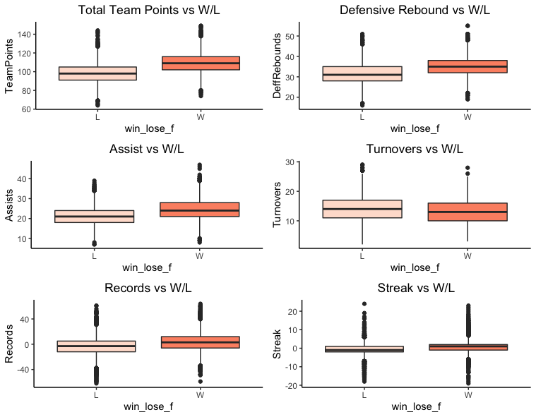
EDA
Promising predictors:
Total points
Assist
Defensive rebound
Turnover
Streak
Record
Is back-to-back
Home court advantage
Multicollinearity:
Total points, field goal, field goal % has high collinearity.
Chose total points
To eliminate predictors:
Transformed predictors to the difference between two teams
e.g. For total points -> total points difference
= total points – opponent total points.
Notes:
For EDA I plotted the promising predictors on the left side. They are total points, assist, defensive rebound, turnover, steak, record, is back to back game, and home court advantage. After checking multicollinearity I found out that total points, field goal and field goal % is highly correlated so I decided to only use total points among the three. Finally, to reduce the number of predictors for each statistics I took the difference between the two teams, this also does some sort of mean centering to the data.

Slide 7
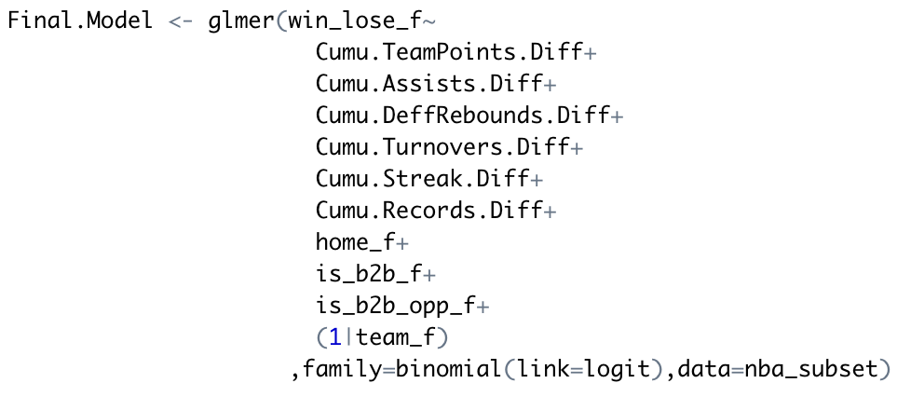
Model
Multi-level Logistic Regression Model
Final Model
ANOVA
Multi-collinearity
Model Assumptions
Notes:
On the right side is my final model. I decided to go with multi-level logistic regression model, controlling for the teams. The model is selected using AIC, BIC and stepwise metrics. I also checked the model assumptions and they looked pretty good.

Slide 8
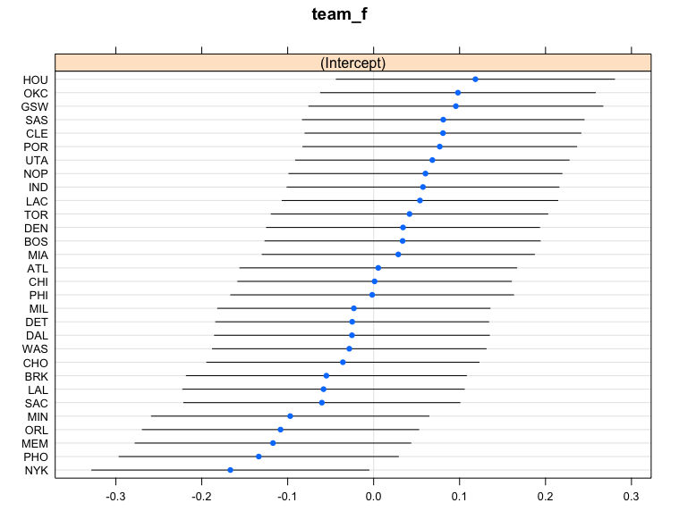
Results
Dot-plot interpretation
Top 5 teams from 2014-2018:
Houston Rockets
Oklahoma City Thunder
Golden State Warriors
San Antonio Spurs
Cleveland Cavaliers
Worst 5 team from 2014-2018
New York Knicks
Phoenix Suns
Memphis Grizzlies
Orlando Magic
Minnesota Timberwolves
Notes:
The dot plot of teams is interesting to look at. It is surprisingly accurate we can see the top 5 teams from 2014-18 are rockets, thunder, warriors, spurs and cavaliers. They were indeed very good teams. And if we look at the bad teams: Knicks, suns, grizzlies, magic, and Timberwolves were pretty bad during that time.

Slide 9
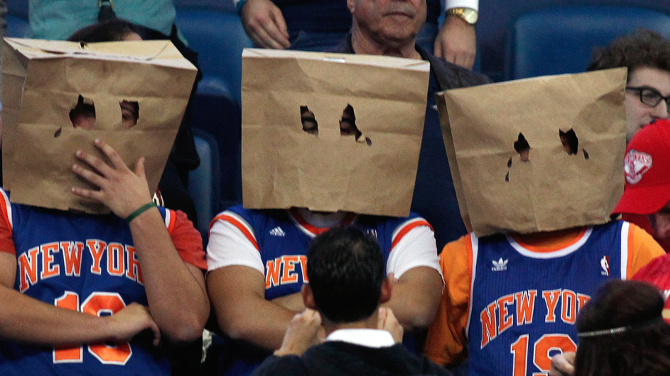
Notes:
And knicks is really bad

Slide 10
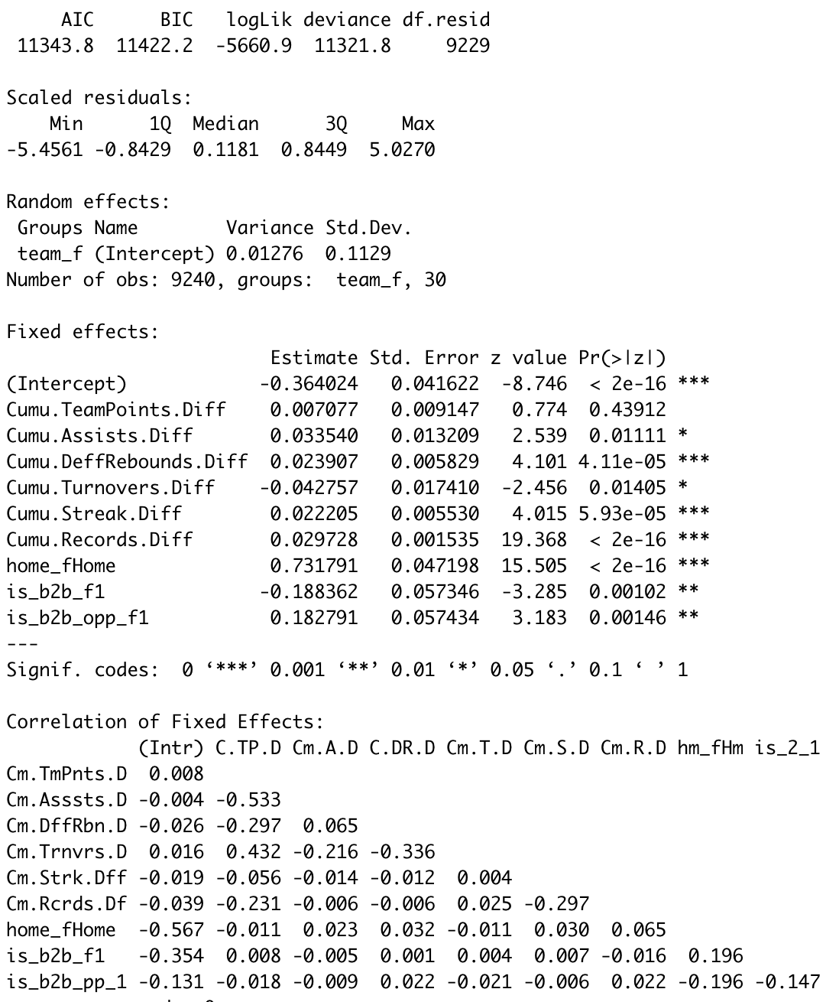
Inference Questions
Model Summary
Q1: Quantify the effect of streak on a team’s chance of winning?
For every winning game counts toward a streak than the opponent, the chance of winning increases by ~ 2%.
Significant (p-value < 0.05), No multi-collinearity
Q2: To what degree does “back-to-back” games influence a team’s winning outcome?
Playing a back-to-back game decrease the chance of winning by ~ 30.7%. Similarly for the opponent due to data symmetry.
Significant (p-value < 0.05), No multi-collinearity
Q3: What in-game statistics affects a team’s odds of winning the most?
Assist: every assist more than opponent increases winning chance by ~ 3%
Turnovers: Every more turnover made than opponent decreases winning chance by ~ 4%
Record: Every won game in the record over opponent’s record increases chance of winning by ~ 3%
Home: Playing a home court game increases chance of winning by ~ 107%
Notes:
To answer the inference questions, I place the model summary on the right side for reference.
For the first question, quantify the effect of streak on a chance of winning. If we interpret the coefficient of streak difference, we can see every increment more than the opponent will increase the chance of winning by 2%.
For the second question, to what degree does “back-to-back” games influence a team’s winning outcome. I found that playing a back to back game decreases the chance of winning by 30.7%
And finally, What in-game statistics affect a team’s of winning the most. I found that every single assist earned more than opponent increases chance of winning by 3%. Turnover decrease by 4%, record increases by 3% and home court advantage increases more than 100%

Slide 11
Conclusion & Limitations
Conclusion:
Teams playing “back-to-back” games significantly lowers their chance of winning.
Streak is not that of a big win condition.
Home court advantage is a huge factor. Assist, turnovers, and record should be considered as well.
Limitations:
Normalize predictors
Symmetry in the dataset
Does not consider the return of the bet
Notes:
To conclude back to back games significantly lowers the chance of winning. Streak is not that of a big win condition. Home court advantage is a huge factor and assist, turnover, record are pretty useful predictors as well.
To talk about the limitations. First of all, I did not normalize the predictors, which may cause some issue. Secondly, there is symmetry in the dataset meaning there are two games representing the same information just from the opponent’s perspective. And lastly, I did not consider the return of the bet. To make this better, I could probably use the prediction probability * ret

Slide 12
Thank You!

